Slide 1

Hotel
Bookings
(Insights on the hotel bookings)
BY SHELDON LUIS NORONHA

Slide 2
Contents
1. OVER VIEW OF HOTEL BOOKING DATA | Hotel Booking Data
 | Pre Processing
2.ANALYSIS | Univariate Analysis
 | Bivariate Analysis
 | Time Series Analysis
 | Actionable Insights

Slide 3

Our goal
- Understand the factors that play major role in the
the Hotel Booking History
- Provide Analysis and Recommendation to Improve Hotel Operation and Customer Satisfaction.

Slide 4
1. OVERVIEW OF HOTEL BOOKING DATA
HOTEL BOOKING DATA
PRE PROCESSING
We show an overview of each attribute of the Hotel Booking Dataset which will be Analyzed.
We show the steps needed to prepare the data pre Analysis.

Slide 5
HOTEL BOOKING DATA
DATA SUMMARY:
Hotel: The type of hotel (City Hotel or Resort Hotel).
Is Canceled: Binary variable indicating if the booking was canceled (1) or not (0).
Lead Time: Number of days between the booking date and the arrival date.
Arrival Date Year: Year of arrival date.
Arrival Date Month: Month of arrival date.
Arrival Date Week Number: Week number of the year for the arrival date.
Arrival Date Day of Month: Day of the month for the arrival date.
Stays in Weekend Nights: Number of weekend nights (Saturday or Sunday) the guest stayed or booked to stay.
Stays in Week Nights: Number of weeknights (Monday to Friday) the guest stayed or booked to stay.
Adults: Number of adults.

Slide 6
HOTEL BOOKING DATA (cont….)
Reserved Room Type: Code of room type reserved. The code is presented instead of designation for anonymity reasons.
Assigned Room Type: Code for the type of room assigned to the booking.
Booking Changes: Number of changes/amendments made to the booking from the moment the booking was entered into the system until the moment of check-in or cancellation.
Deposit Type: Indication on if the customer made a deposit to guarantee the booking. This variable can assume three categories: No Deposit, Non Refund, and Refundable.
Agent: ID of the travel agency that made the booking.
Company: ID of the company/entity that made the booking or responsible for paying the booking. This variable can assume several categories.
Days in Waiting List: Number of days the booking was in the waiting list before it was confirmed to the customer.
Customer Type: Type of booking, assuming one of four categories: Contract, Group, Transient, and Transient-party.

Slide 7
HOTEL BOOKING DATA (cont….)
ADR (Average Daily Rate): The average daily rate as defined by dividing the sum of all lodging transactions by the total number of staying nights.
Required Car Parking Spaces: Number of car parking spaces required by the customer.
Total of Special Requests: Number of special requests made by the customer (e.g., twin bed or high floor).
Reservation Status: Reservation last status, assuming one of three categories: Canceled, Check-Out, and No-Show.
Reservation Status Date: Date at which the last status was set. This variable can help in understanding when was the booking canceled or when did the customer check out of the hotel.

Slide 8
PRE PROCESSING
Data Pre Processing is a crucial step prior to Analysis as data needs to be clean and sorted so as to conduct proper Analysis later.
Duplicate Data
Missing Data
Repeated/duplicate entries
Cause - Analysis to be biased leads to false recommendations,
Solution - Keep a single entry and dispose of duplicate entries.
Missing Entries
Cause - Analysis to miss out on important data leads to false analysis & recommendations,
Solution - Fill missing with unbiased values or drop the rows of missing data are few
Creating New Columns
Correcting Data Types
Cause – Interpretation of data in dataset having a wide range of attributes is difficult,
Solution - Minimize the number of attributes by combining 2 or more into a new column, eg: arrival date(day/month/year), total guests (adults + babies + infants)
Cause – Error during analysis & improper analysis ,
Solution - Convert wrongfully assigned data types to the correct datatype

Slide 9
2. ANALYSIS
To understand what the information we get from the data via tables or charts and get a in depth understanding to make better decision / recommendations regarding the future of the Hotel and its Customers
Univariate Analysis
Bivariate Analysis
Analysis based on a Single Attribute.
Analysis based on two or more Attributes
Time Series Analysis
Insights
Analysis based on Time or related to Time
We will provide insights and recommendation of data

Slide 10
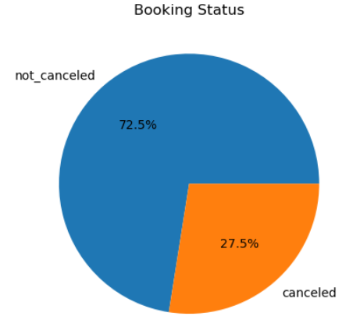
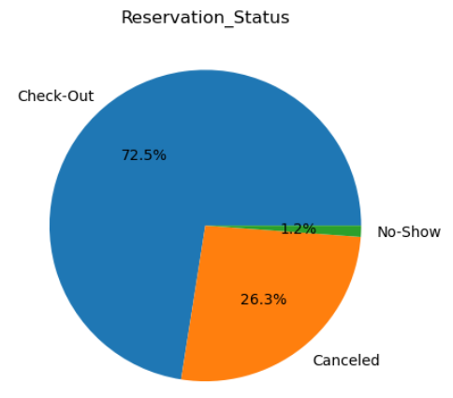
1. Univariate Analysis
Total No. of Bookings
87,396
Bookings Cancelled
Bookings Not Cancelled
24,025
63,371
Canceled
Check Out
23,011
63,371
No Show
1,014

Slide 11

53,428
City Hotel Bookings
Resort Hotel Bookings
33,968

Slide 12

1,76,999
178
3,415
Total No. of Guests
Total No. of Countries from which guests book
Total No. of Repeat Guests
Total No. of Guest’s Special Requests
61,052

Slide 13
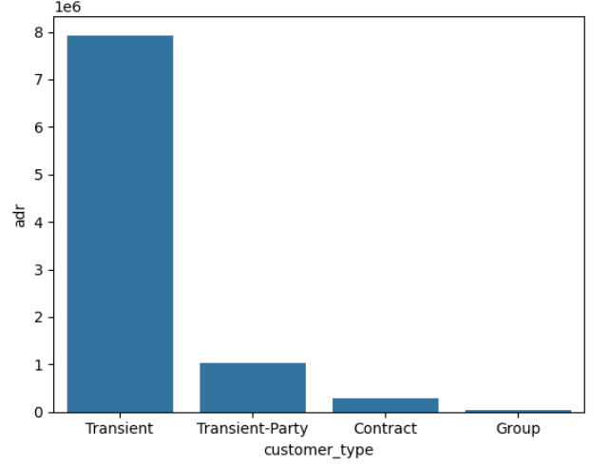
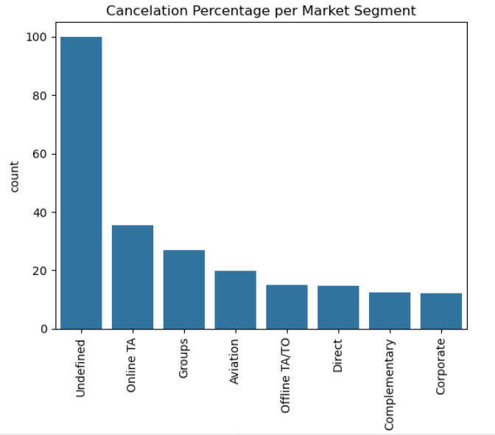
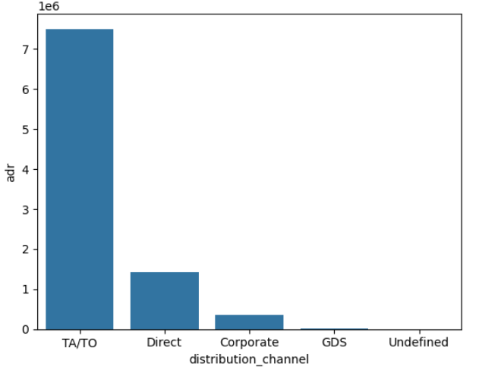
2. Bivariate Analysis
Distribution of ADR across different customer types
Transient customers has the highest ADR 7,928,239
Group customers has lowest ADR 45,892
Cancellation Rate for each Market Segment
Highest Cancellation Rate is for UNDEFINED (unknown) market segment at 100%
Lowest Cancellation Rate is for Corporate market segment at 12%
Distribution of ADR across different Distribution Channels
TA/TO has the highest Distribution channel ADR (7,505,885)
Undefined has the Lowest Distribution channel ADR (231)

Slide 14
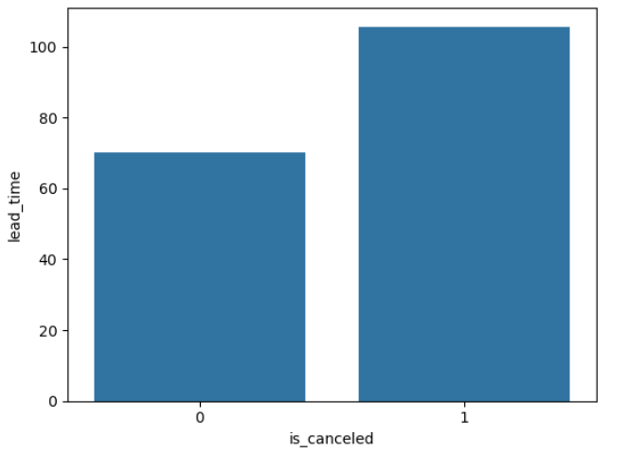
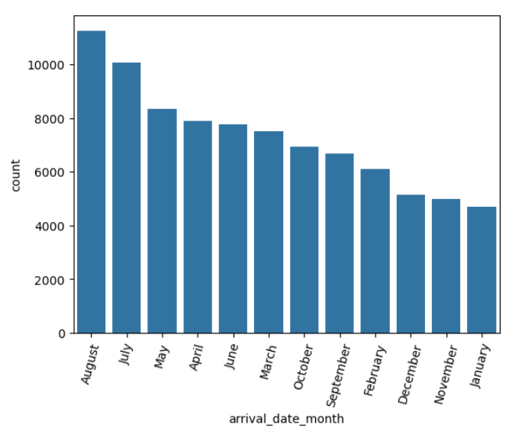
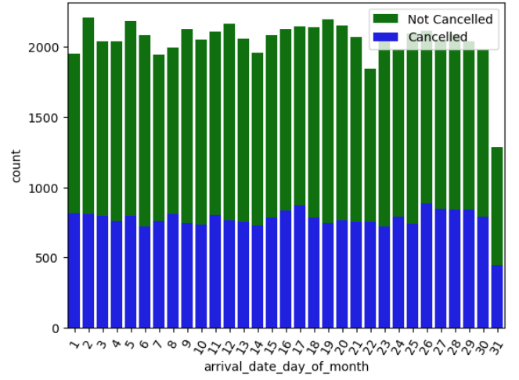
3. Time Series Analysis
Average Lead Time taken for Bookings
The average lead time for cancelled bookings is 70 days
The average lead time for non cancelled booking is 105 days
Month wise Booking
August has the Highest number of bookings (i.e. 11257),
January has the Lowest no. with 4693 bookings
Day Wise Cancellations
The average lead time for cancelled bookings is 70 days
The average lead time for non cancelled booking is 105 days

Slide 15
4. Insights & Recommendations
Hotel:
City Hotel has the highest number of Bookings making it the most Profitable Hotel Types.
However Resort Hotels has relatively a less number of bookings hence has area for improvements.
Lead Time:
The Average Lead Time for Cancelled is greater than Non Cancelled.
Arrival Date Year:
Year wise the Bookings increased from 2015 (30) to 2016 (160) and a decrease there after from 2016 to 2017 (120) with the number of guests being 50% of booking numbers.
The Average Lead time has increased over the years from 60 to 80 to 100 days respectively.
The increase in Lead time is a call fro concern hence needs to be address regarding the factors affect it.

Slide 16
Arrival Date Month:
The Average Lead Time for each Month is highest in the Months June to September (seasonal).
The Bookings have been the most from March to August, however while also have 1/3 rd of their bookings being canceled except in case of March which is lower
The cancellations need to be reduces below 33% w.r.t Lead Time
Country :
The Hotels cater to International Guests (not from INDIA) which is 99.99% of Guests
Portugal nationals being the majority guests (31.5%) followed by Great Britain (12%)
Domestic Customers seam to have a low count, 1/3rd of booking have nor cancelled hence needs to focus on Foreign Guests
Cancellations:
27% of the Bookings lead to cancellations
Cancellations are Relatively Less is majority of the Foreign Gues Bookings
Reservation Status:
Out of the 73% of Non Cancelled Bookings all are converted into “Check Out”
Out of the 27% of Cancelled Bookings 26% are “Cancelled” while 1% are “No Show”.
If the Reason fro Cancellations were available then we could reduce the cancellations further.

Slide 17


